Slide 1
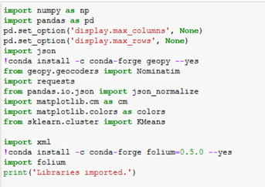


First Library File are Imported

Slide 2
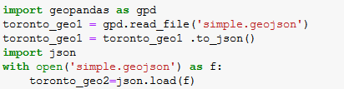
geojson file is converted into json file
For mapping data onto map file conversion is imported

Slide 3
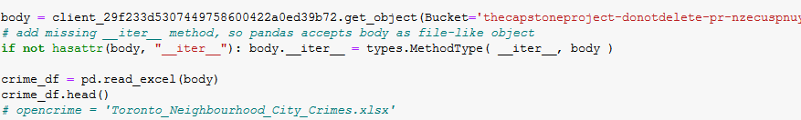
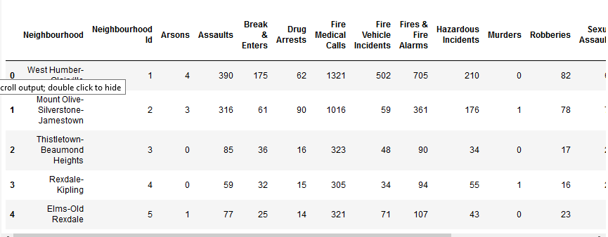
Crime Data from TORONTO city is imported into Datafreame

Slide 4
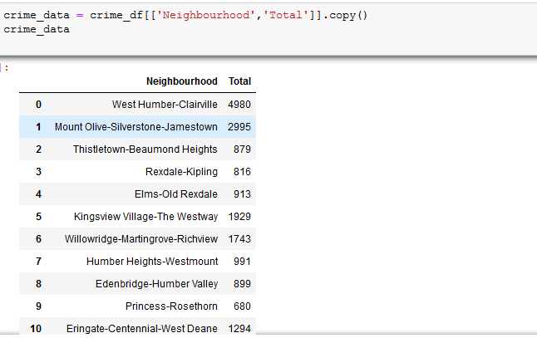
From data-frame only Neighbourhood and Total columns are selected for further processing

Slide 5
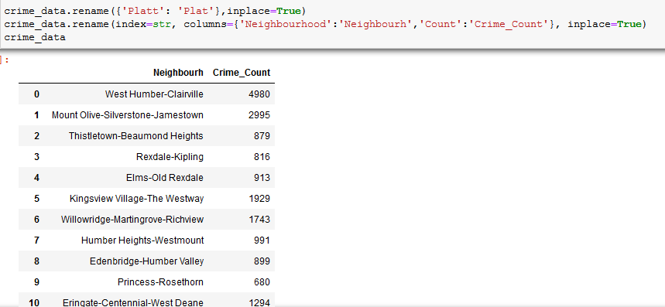
‘Total’ column is renamed as ‘Crime_Count’

Slide 6
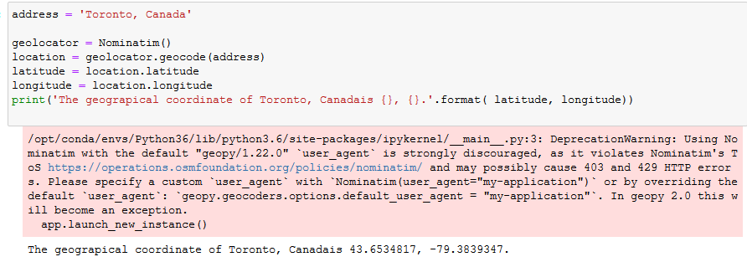
Getting address of ‘TORONTO’

Slide 7
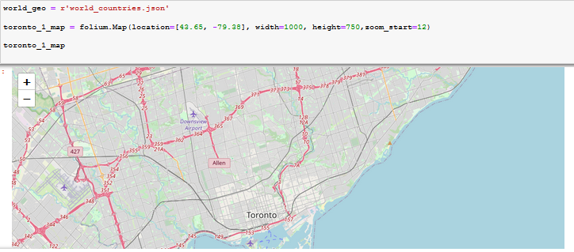
‘TORONTO’ map

Slide 8
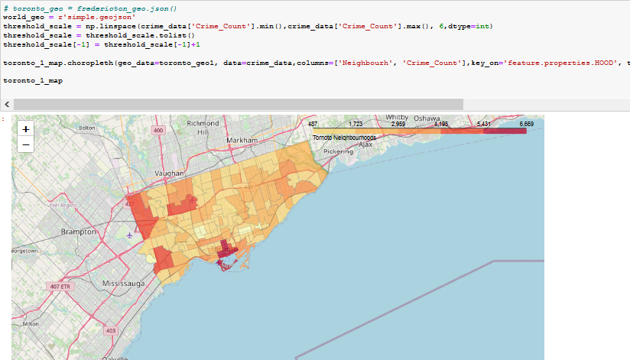
Plotting ‘Crimes’ against ‘City’

Slide 9
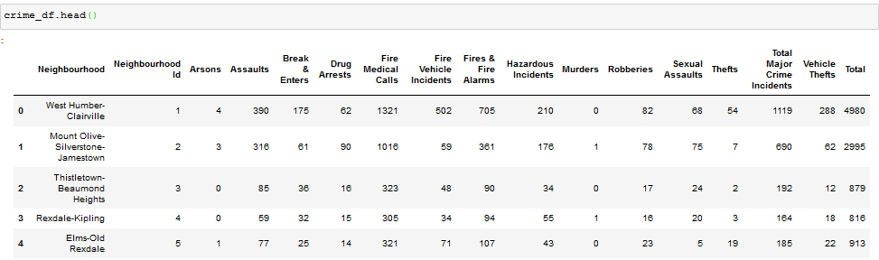
Getting Crime Data categorywise

Slide 10
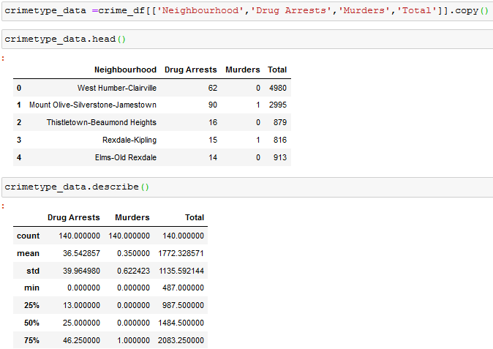
From all crimes we select ‘Drug Arrests’, ’Murders’ and ‘Total’

Slide 11
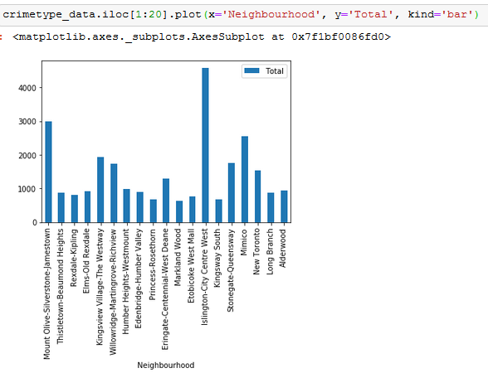
Creating chart of ‘Crimes V/S City’

Slide 12
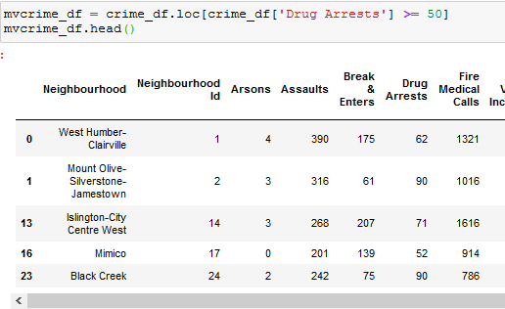
Checking ‘Drug Arrest’ to check which cities are not safe

Slide 13
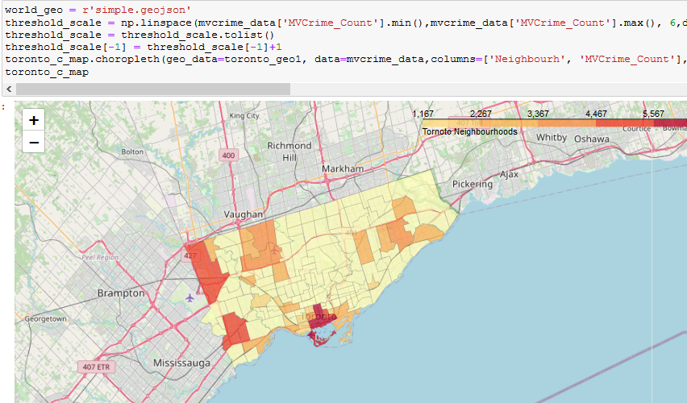
These ‘Drug Crimes’ are plotted against City

Slide 14
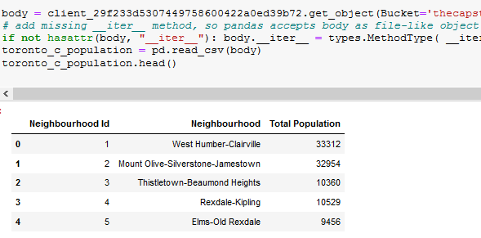
Now we will check for the population density of the city for crime rates

Slide 15
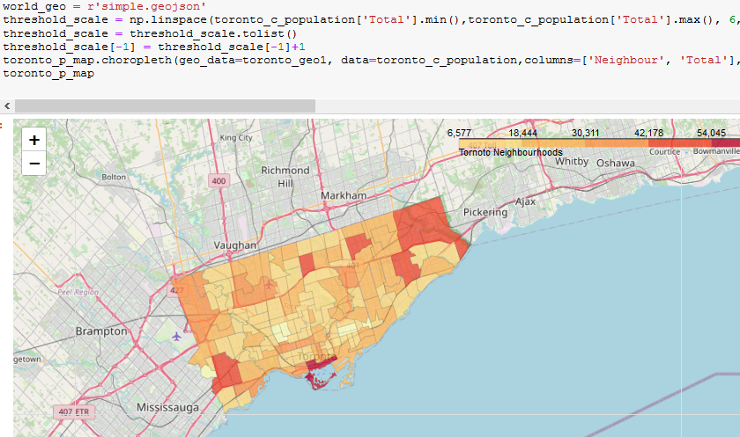
Plotting city population on map

Slide 16
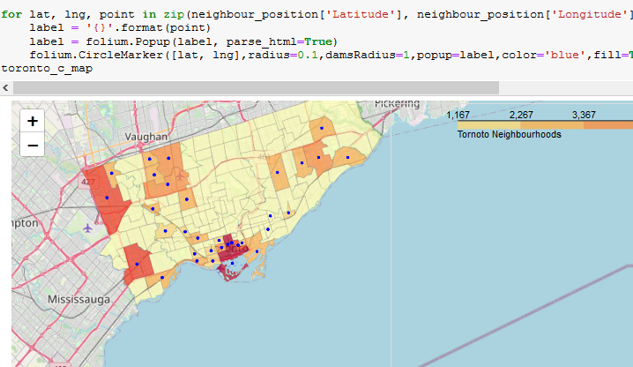
Now identifying population and crime relation
This indicates when population is more crimes takes place. These places are not safe for business

Slide 17
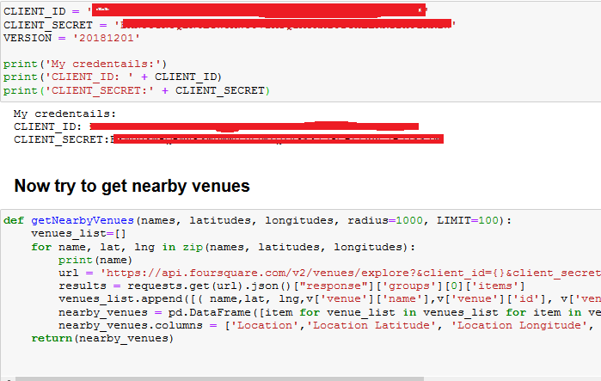
Getting near by venues of TORONTO cities using Foursquare web portal

Slide 18
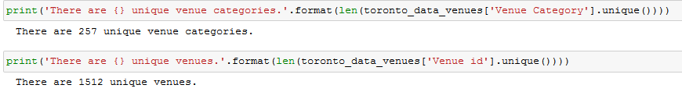

Fetched the data
Then we try to Analyze each Location
Then group rows by location and by the mean of the frequency of occurrence of each category. After grouping Data Shape is

Slide 19
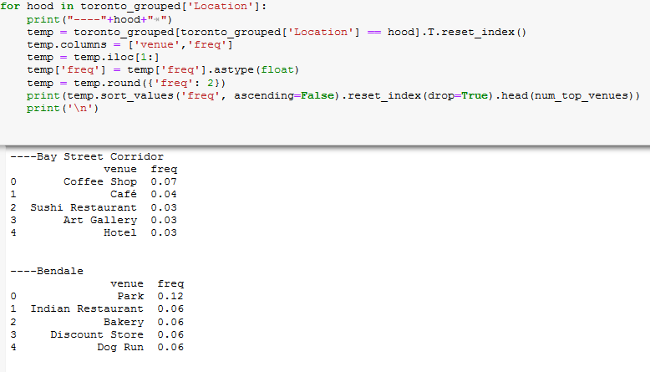
Now try to print each Location with the top 5 most common venues

Slide 20
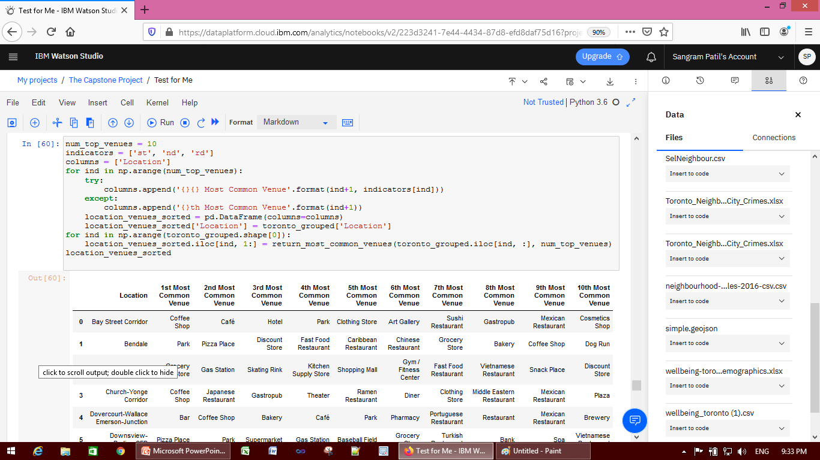
Selected only few records which are interested like coffee shop, pizza place etc….

Slide 21
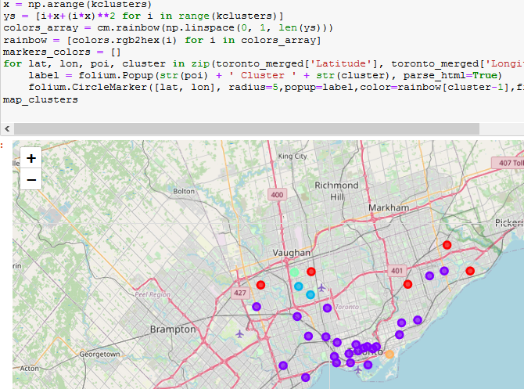
These locations are clustered as
This indicates the number of location having same facilities to start the business

